Slide 1

FOOD DELIVERY TIME PREDICTION
PROJECT WITH LSTM NEURAL NETWORK

Slide 2

CENTURION UNIVERSITY OF
TECHNOLOGY & MANAGEMENT BHUBANESWAR, ODISHA
MACHINE LEARNING USING PYTHON
CODE – CUTM1019
OUR TEAM
YASH AARYAN – 220301120263
KUMAR AVINASH – 220301120273
SUBHALAXMI NAYAK – 220301120287
SWAPNIL RAY – 220301120295
HIMANSU AGRAWAL - 220301120291

Slide 3






01
CONTENT
02
OBJECTIVE
OF THE
PROJECT
03
SCOPE
ALGORITHM
USED
04
05
DATA
GRAPH PLOTINGS
06
LSTM
MODEL
BUILDING
CONCLUSION

Slide 4


LET’S
STARTS
SCOPE
OBJECTIVE
LIBRARIES
INTRODUCTION

Slide 5
Make an accurate estimate of when the food will arrive, thus increasing customer satisfaction.
Plan delivery routes and driver schedules more efficiently by predicting how many orders will arrive so that delivery providers can use their resources better.
Make deliveries faster by looking at past delivery data and determining the attributes that affect them.
Grow business because of buyer satisfaction with the speed of delivery.
Based on these goals, we will use the LSTM Neural Network to develop a model that can estimate the delivery time of orders accurately based on the age of the delivery partner, the partner’s rating, and the distance between the restaurant and the buyer’s place.
SCOPE
OBJECTIVE
LIBRARIES
INTRODUCTION

Slide 6
More businesses are moving online these days, and consumers are ordering online instead of traveling to the store to buy.
Zomato and Swiggy are popular online platforms for ordering food products.
In online food-ordering businesses, delivery time is critical.
As a result, estimated food delivery time prediction to reach the buyer’s location is critical.
SCOPE
LIBRARIES
OBJECTIVE
INTRODUCTION

Slide 7
The goal of the project "Online Food Delivery Time Prediction using Machine Learning" is to create a predictive model that predicts how long it will take to deliver food using an online ordering system.
Data on the delivery time, including the distance between the restaurant and the delivery site, traffic conditions, and order preparation time, would need to be gathered and processed for the project.
Platforms for ordering food online, location-based services, and traffic monitoring systems all have APIs that can be used to acquire the data.
LIBRARIES
OBJECTIVE
INTRODUCTION
SCOPE

Slide 8
NumPy provides fast mathematical functions for multidimensional arrays, while Pandas makes it easier to analyze and manipulate data with more complex data structures like Data Frames and Series.
Meanwhile, the Plotly Express library makes it easy for users to create interactive visualizations in Python. It can use minimal code to create various charts, such as scatter plots, line charts, bar charts, and maps.
The Sequential class is a type of model in Keras that allows users to create a neural network by adding layers to it in sequential order.
Then, Dense and LSTM are to create layers in the Keras model and also customize their configurations.
LIBRARIES
OBJECTIVE
SCOPE
INTRODUCTION

Slide 9
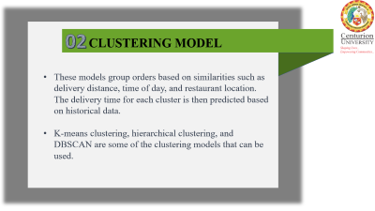
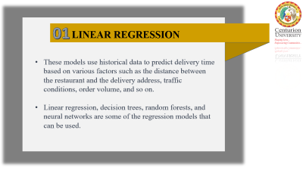
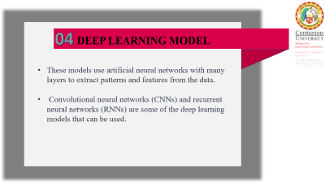
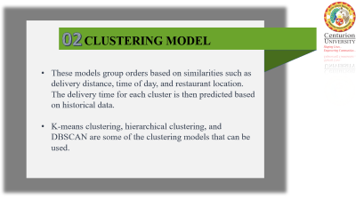
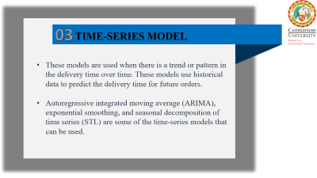
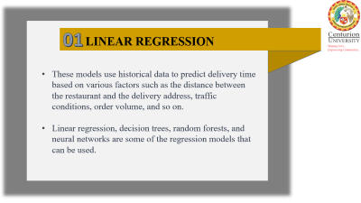
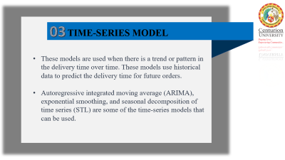
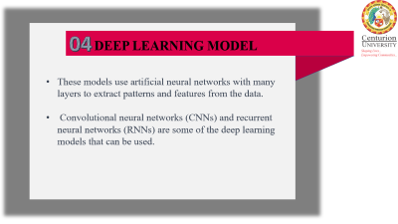
ALGORITHMS
USED

Slide 10
01
LINEAR REGRESSION
These models use historical data to predict delivery time based on various factors such as the distance between the restaurant and the delivery address, traffic conditions, order volume, and so on.
Linear regression, decision trees, random forests, and neural networks are some of the regression models that can be used.

Slide 11
02
CLUSTERING MODEL
These models group orders based on similarities such as delivery distance, time of day, and restaurant location. The delivery time for each cluster is then predicted based on historical data.
K-means clustering, hierarchical clustering, and DBSCAN are some of the clustering models that can be used.

Slide 12
03
TIME-SERIES MODEL
These models are used when there is a trend or pattern in the delivery time over time. These models use historical data to predict the delivery time for future orders.
Autoregressive integrated moving average (ARIMA), exponential smoothing, and seasonal decomposition of time series (STL) are some of the time-series models that can be used.

Slide 13
04
DEEP LEARNING MODEL
These models use artificial neural networks with many layers to extract patterns and features from the data.
Convolutional neural networks (CNNs) and recurrent neural networks (RNNs) are some of the deep learning models that can be used.

Slide 14
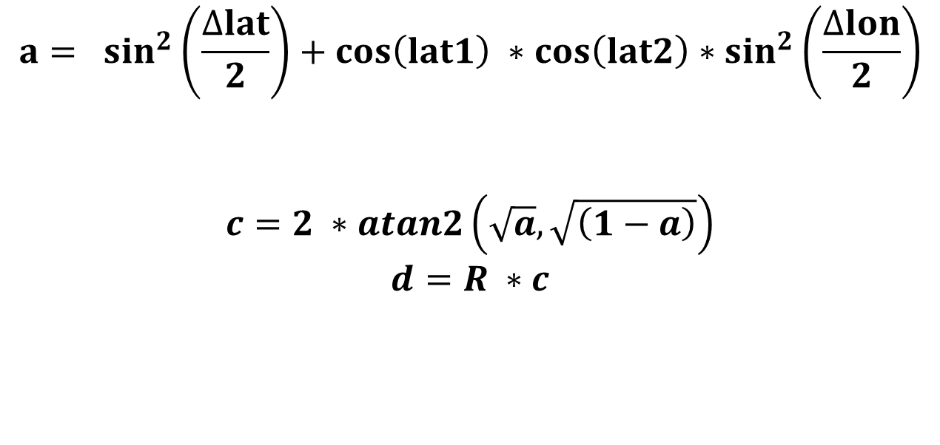
HARVERISINE FORMULA
It takes the latitude and longitude of two points and converts the angles to radians to perform the necessary calculations.
We use this formula because the dataset doesn’t provide the distance between the restaurant and the delivery location.
There are only latitude and longitude. So, let’s calculate it and then create a distance column in the dataset.
$$a= \sin^{2}\left(\frac{∆lat}{2}\right)+\cos\left(lat1\right) ∗\cos\left(lat2\right)∗\sin^{2}\left(\frac{∆lon}{2}\right)$$
$$c=2 ∗atan2\left(\sqrt{a}, \sqrt{\left(1−a\right)}\right)$$
$$d=R ∗c$$
a1
a2

Slide 15
R = 6371 ##The earth's radius (in km)
def deg_to_rad(degrees):
return degrees * (np.pi/180)
## The haversine formula
def distcalculate(lat1, lon1, lat2, lon2):
d_lat = deg_to_rad(lat2-lat1)
d_lon = deg_to_rad(lon2-lon1)
a1 = np.sin(d_lat/2)**2 + np.cos(deg_to_rad(lat1))
a2 = np.cos(deg_to_rad(lat2)) * np.sin(d_lon/2)**2
a = a1 * a2
c = 2 * np.arctan2(np.sqrt(a), np.sqrt(1-a))
return R * c
# Create distance column & calculate the distance
Data['distance'] = np.nan
for i in range(len(Data)):
Data.loc[i, 'distance'] = distcalculate(Data.loc[i, 'Restaurant_latitude'],
Data.loc[i, 'Restaurant_longitude'],
Data.loc[i, 'Delivery_location_latitude'],
Data.loc[i, 'Delivery_location_longitude'])

Slide 16
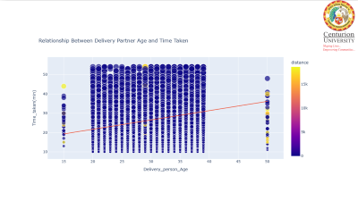
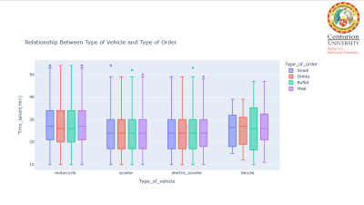
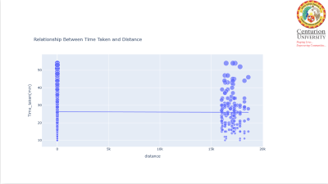
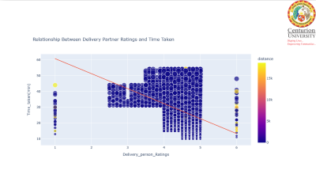
DATA
VISUALISATION

Slide 17
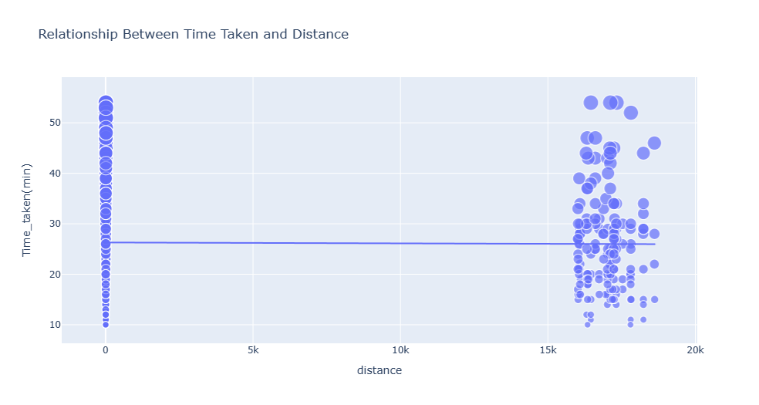
DATA
VISULISATION

Slide 18
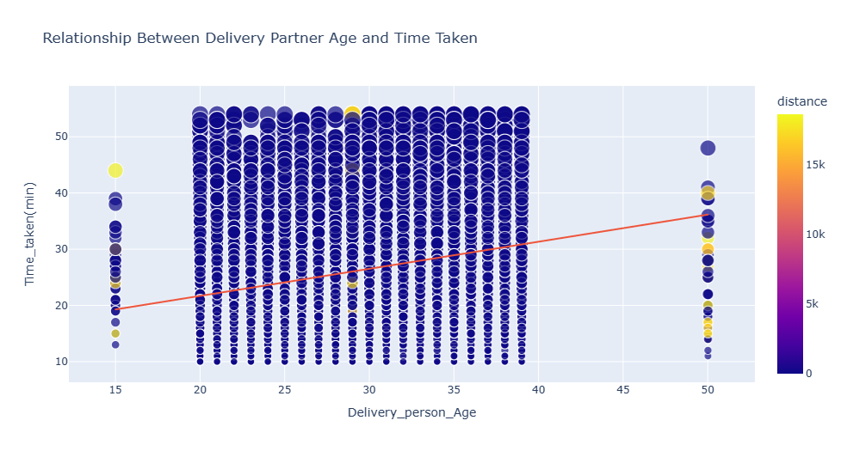
DATA
VISULISATION

Slide 19
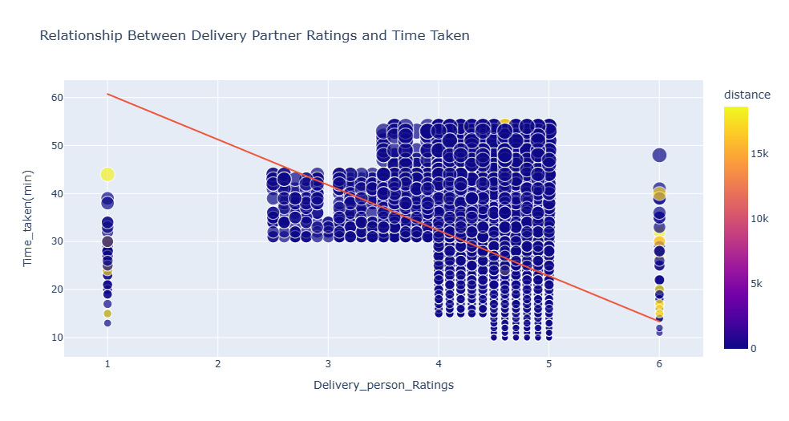
DATA
VISULISATION

Slide 20
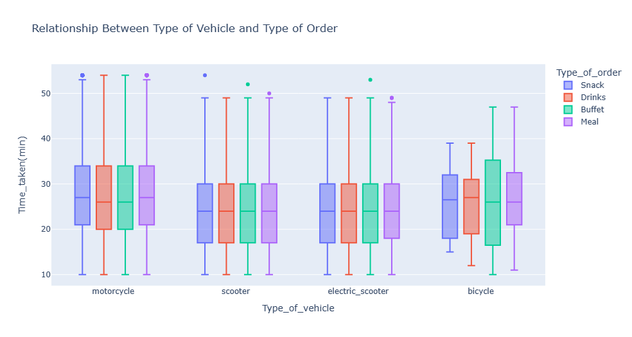

Slide 21
Through the analysis above, we can determine that the delivery partner’s age, the delivery partner’s rating, and the distance between the restaurant and the delivery location are the features that have the most significant impact on food delivery time.
THINGS TO
NOTE DOWN!!
FROM GRAPH
Previously, we have determined three features that significantly affect the time taken, namely the delivery partner’s age, the delivery partner’s rating, and distance.
So the three features will become independent variables (x), while the time taken will become the dependent variable (y).

Slide 22
LSTM NEURAL NETWORK
LSTM (Long Short-Term Memory) neural networks are a type of recurrent neural network (RNN)
that is particularly effective in handling sequences of data.
They are widely used in machine learning for various tasks involving sequential or time-dependent data, such as natural language processing (NLP), speech recognition, machine translation, sentiment analysis, and more.
Now, we need to train an LSTM neural network to predict food delivery time.
The aim is to create a precise model that uses features like distance, delivery partner age, and rating to estimate food delivery time.
The trained model can then be used to predict new data points or unseen scenarios.

Slide 23
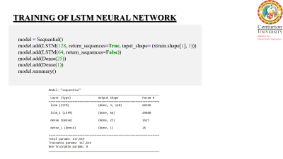
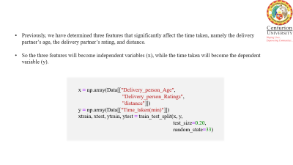
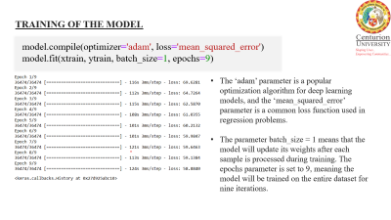
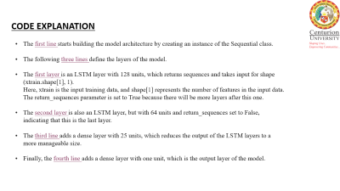
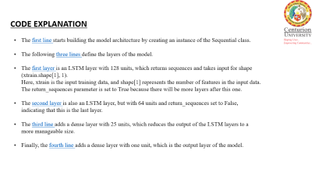
LSTM
NEURAL NETWORK BUILDING

Slide 24
Previously, we have determined three features that significantly affect the time taken, namely the delivery
partner’s age, the delivery partner’s rating, and distance.
So the three features will become independent variables (x), while the time taken will become the dependent variable (y).
x = np.array(Data[["Delivery_person_Age",
"Delivery_person_Ratings",
"distance"]])
y = np.array(Data[["Time_taken(min)"]])
xtrain, xtest, ytrain, ytest = train_test_split(x, y,
test_size=0.20,
random_state=33)

Slide 25
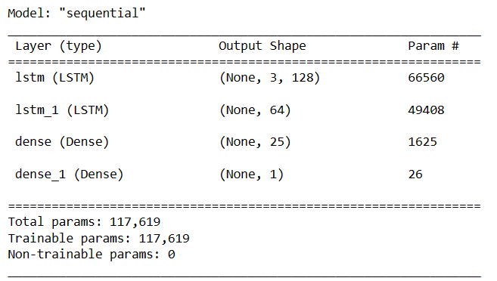
TRAINING OF LSTM NEURAL NETWORK
model = Sequential()
model.add(LSTM(128, return_sequences=True, input_shape= (xtrain.shape[1], 1)))
model.add(LSTM(64, return_sequences=False))
model.add(Dense(25))
model.add(Dense(1))
model.summary()

Slide 26
CODE EXPLANATION
The first line starts building the model architecture by creating an instance of the Sequential class.
The following three lines define the layers of the model.
The first layer is an LSTM layer with 128 units, which returns sequences and takes input for shape
(xtrain.shape[1], 1).
Here, xtrain is the input training data, and shape[1] represents the number of features in the input data.
The return_sequences parameter is set to True because there will be more layers after this one.
The second layer is also an LSTM layer, but with 64 units and return_sequences set to False, indicating that this is the last layer.
The third line adds a dense layer with 25 units, which reduces the output of the LSTM layers to a more manageable size.
Finally, the fourth line adds a dense layer with one unit, which is the output layer of the model.

Slide 27
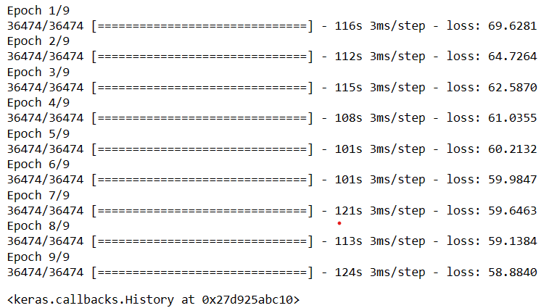
TRAINING OF THE MODEL
model.compile(optimizer='adam', loss='mean_squared_error')
model.fit(xtrain, ytrain, batch_size=1, epochs=9)
The ‘adam’ parameter is a popular optimization algorithm for deep learning models, and the ‘mean_squared_error’ parameter is a common loss function used in regression problems.
The parameter batch_size = 1 means that the model will update its weights after each sample is processed during training. The epochs parameter is set to 9, meaning the model will be trained on the entire dataset for nine iterations.

Slide 28
FINALLY, LET’S TEST THE MODEL’S PERFORMANCE FOR PREDICTING FOOD DELIVERY TIMES GIVEN THREE INPUT PARAMETERS
(DELIVERY PARTNER AGE, DELIVERY RATING, AND DISTANCE)

Slide 29
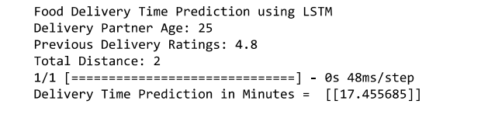
print("Food Delivery Time Prediction using LSTM")
a = int(input("Delivery Partner Age: "))
b = float(input("Previous Delivery Ratings: "))
c = int(input("Total Distance: "))
features = np.array([[a, b, c]])
print("Delivery Time Prediction in Minutes = ", model.predict(features))
The Final Result :

Slide 30
The given result is a prediction of the delivery time for a hypothetical food delivery order based on the trained LSTM neural network model using the following input features:
Delivery Partner’s Age: 25
Previous Delivery Ratings: 4.8
Total distance: 2
The output of the prediction is shown as “Delivery Time Prediction in Minutes = [[17.455685]],” which means that the model has estimated that the food delivery will take approximately 17.50 minutes to reach the destination.

Slide 31
Predicting food delivery times is an important problem that can be solved using a combination of data preprocessing, feature engineering, exploratory data analysis, model selection, training and validation, hyperparameter tuning, model evaluation, and deployment.
CONCLUSION
By following these steps, we can build an accurate and reliable food delivery time prediction model that can help improve customer satisfaction and increase business revenue.

Slide 32
WHAT WE
HAVE BEEN
READ
THE DATA
WORKING ON??
DATA VISUALISATION
DISTANCE
CALCULATION
FEATURES
AFFECTED
MADE A
LSTM MODEL

Slide 33
O
T
A
K
Y
U
H
N

